Slide 1
Boosting Algorithms

Slide 2
Gradient Boosting
Gradient boosting is a machine learning technique used in regression and classification tasks.
It is one of most popular machine learning algorithm for classification as well as regression task.
It uses Decision Tree algorithm as a base model.
Decision tree is used because it has been proved that this algorithm performs best when it comes to accuracy of the model.
GB works and trains on error data point.

Slide 3
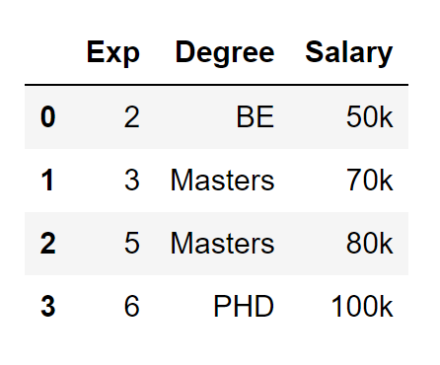
Working of Gradient Boosting
Let’s take this example. In this data we have Experience and Degree as independent variables and Salary is target column.
First step in GB algorithm is it gives you prediction as average of target column always.

Slide 4
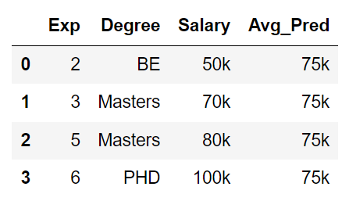
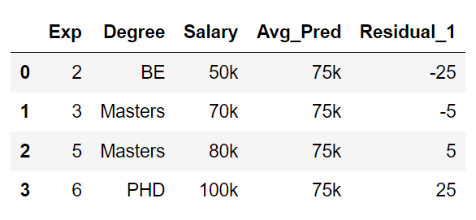

Slide 5
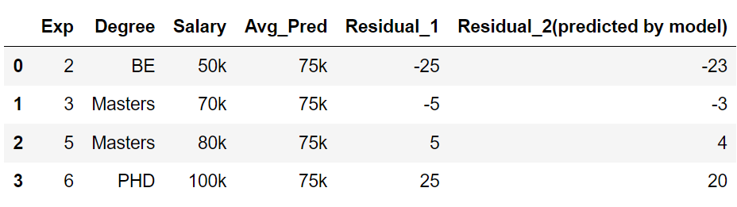
Now, we will get the prediction from these calculated residuals with the formula:
Ypred = Avg_pred + Residual_2
= 75+(-23) = 52
Ypred = Avg_pred +Residual_2
= 75+(-3) = 72
And so on…
Is this really a good model?

Slide 6
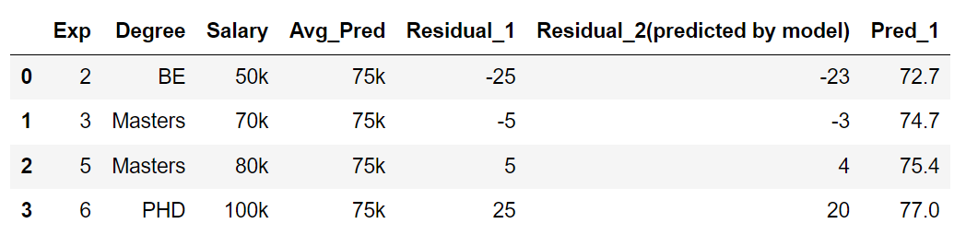
Answer is NO!
This model is overfitted as it is able to predict actual training data perfectly.
In order to overcome this overfitted result, we take different formula to calculate the predictions and the formula is:
Ypred = Avg_pred + α (Residual_2)
where α is a hyperparameter!
Values range from 0–1 with typical values between 0.001–0.3.
Let’s take learning rate = 0.1.
Ypred = Avg_pred+ (0.1)*(Residual_2)

Slide 7
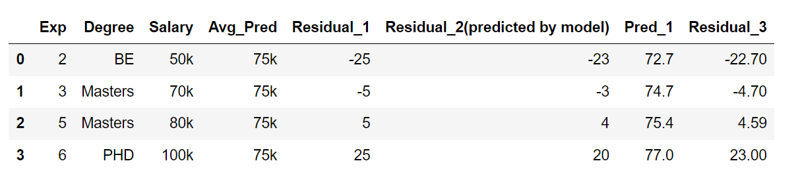

Slide 9
Extreme Gradient Boosting
Extreme Gradient Boosting, or XGBoost for short is an efficient open-source implementation of the gradient boosting algorithm. As such, XGBoost is an algorithm, an open-source project, and a Python library.
The two main reasons to use XGBoost are execution speed and model performance.
Generally, XGBoost is fast when compared to other implementations of gradient boosting.
XGBoost dominates structured or tabular datasets on classification and regression predictive modeling problems.
A large and growing list of data scientists globally that are actively contributing to XGBoost open source development.

Slide 10
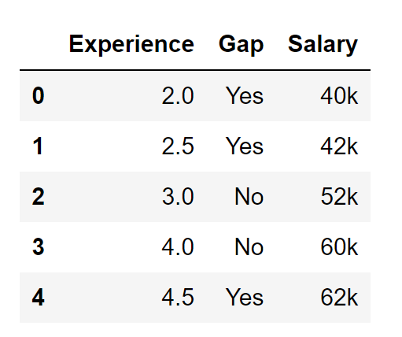
Working of XGB
Let’s take this dataset where we have 3 columns.
Experience and Gap are independent variables and Salary is a target column.
Based on X1 and X2 we have to predict the salary of a person.

Slide 11
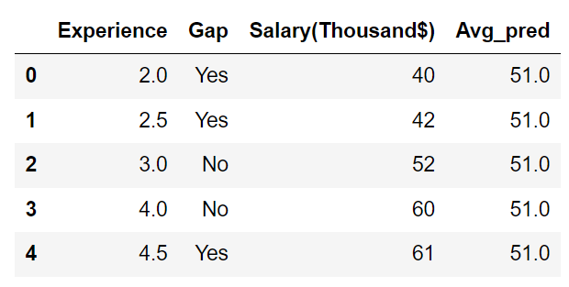
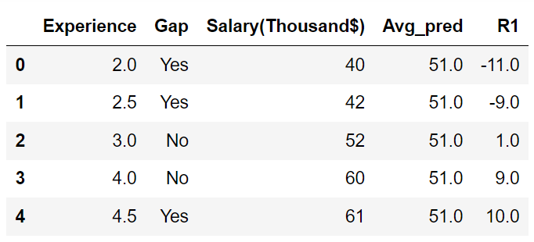
Step 1: Average prediction
Step 2 : Calculating residual

Slide 12
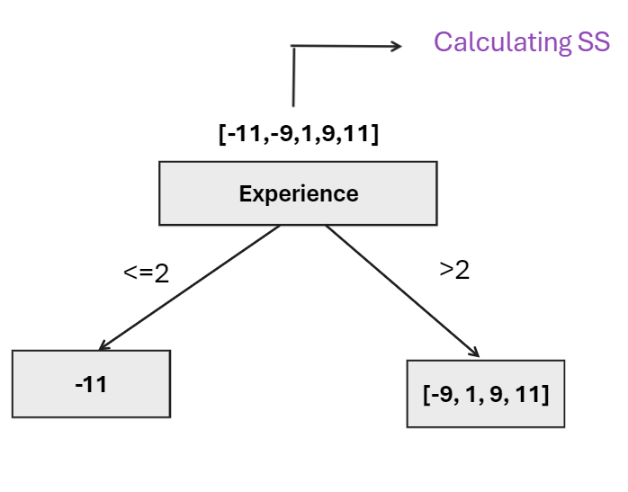
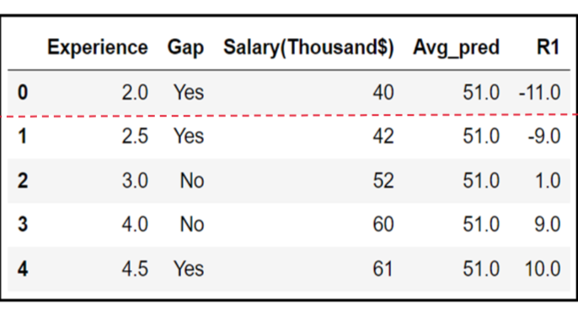
Similarity Score = (Sum of Residuals)^2 / (number of Residuals + λ )
Gain = Left Similarity + Right Similarity - Root Similarity

Slide 14
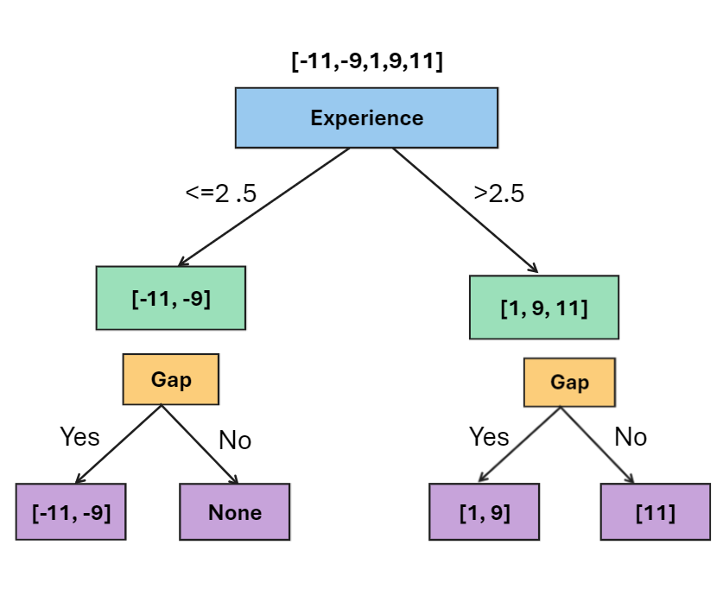
Let’s Say Experience 2.5 has maximum Gain. It will be selected as splitting condition and the final tree will look this:
New prediction = Avg_pred + α*(Output value)
α is a hyperparameter!
Let’s take α = 0.5 for getting predictions.

Slide 15
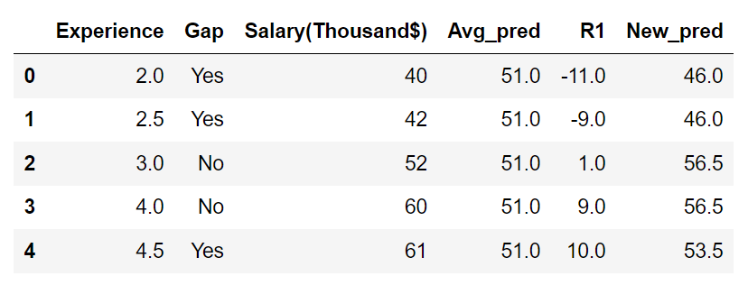
This is how the new predicted values will look:

